Slide 1


News Article Sorting
MOHAMMAD WASIQ
gl0427@myamu.ac.in

Slide 2


Objective
Dataset
Data Description
Architecture
Data Analysis steps
EDA
Database Connectivity
Model Selection
Prediction Result
Deployment
Q & A

Slide 3
Objective
In today’s world, data is power. With News companies having terabytes of data stored in servers, everyone is in the quest to discover insights that add value to the organization. With various examples to quote in which analytics is being used to drive actions, one that stands out is news article classification.
Nowadays on the Internet there are a lot of sources that generate immense amounts of daily news. In addition, the demand for information by users has been growing continuously, so it is crucial that the news is classified to allow users to access the information of interest quickly and effectively. This way, the machine learning model for automated news classification could be used to identify topics of untracked news and/or make individual suggestions based on the user’s prior interests.

Slide 4
Approach
Techniques like clustering and associating rule-based algorithms can be applied to group together similar text. The ML algorithms learn the mapping function between the text and the tags based on already categorized data. Algorithms such as SVM, Neural Networks, Random Forest are commonly used for text classification.

Slide 5
Result
For a given news article, the system should be able to classify them according to various categories like Finance, Sports etc. You have to build a solution that should recognize and classify the news articles based on their labels

Slide 6
Dataset
The dataset provided to us contains many rows, and 2 independent features. We aim to predict category of a news. So this clearly is a classification problem, and we will train the classification models to predict the desired outputs based on input News.
Link: https://www.kaggle.com/c/learn-ai-bbc/data

Slide 7
Data Description
Article Id – Article id unique given to the record
Article – Text of the header and article
Category – Category of the article (tech, business, sport, entertainment, politics)

Slide 8
Requirements
Python (Programming Language version 3.7+)
Flask (Python Backend Framework)
sklearn (Machine Learning Library)
git (Version Control Distribution)
nltk (python library for NLP)
pandas (Python Library for Data operations)
NumPy (Python Library for Numerical operations)
VS code (IDE)

Slide 9
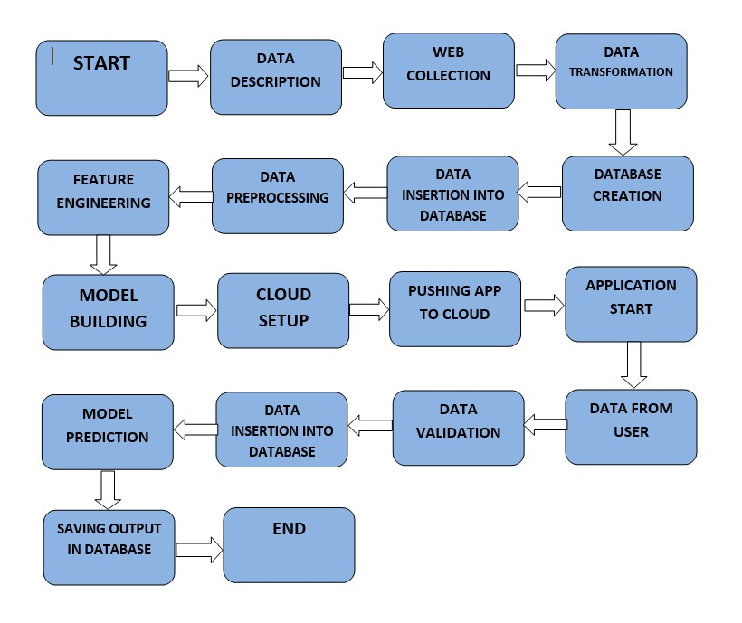
Architecture

Slide 10
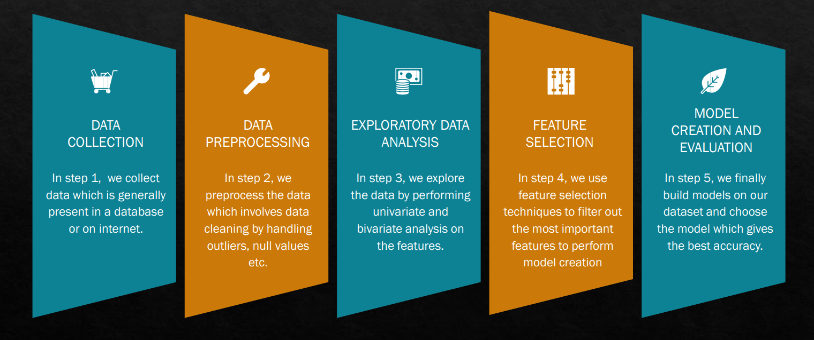
Data Analysis step

Slide 11
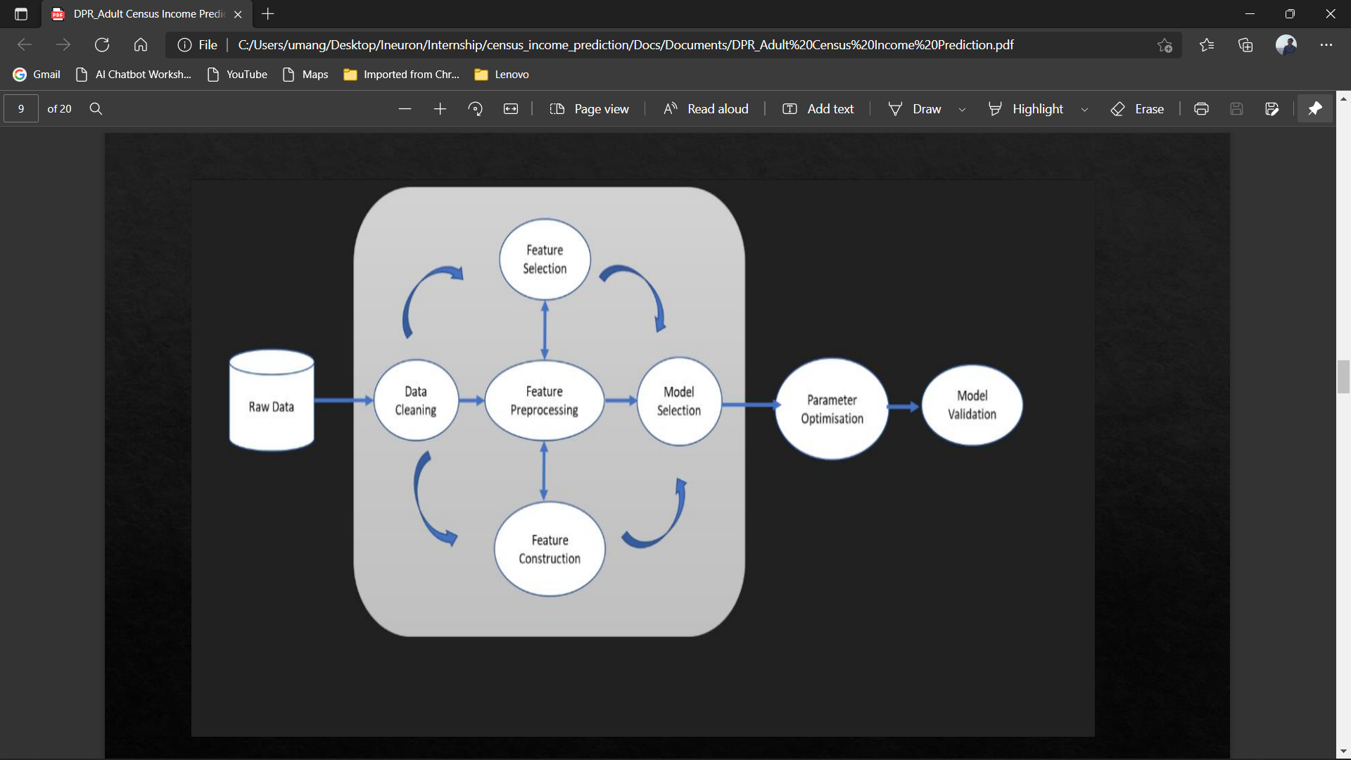

Slide 12
EDA and Feature Engineering
Checking for imbalanced dataset
Tokenize Data
Stemming
Removing Stopwords
TFIDF Vectorizer

Slide 13
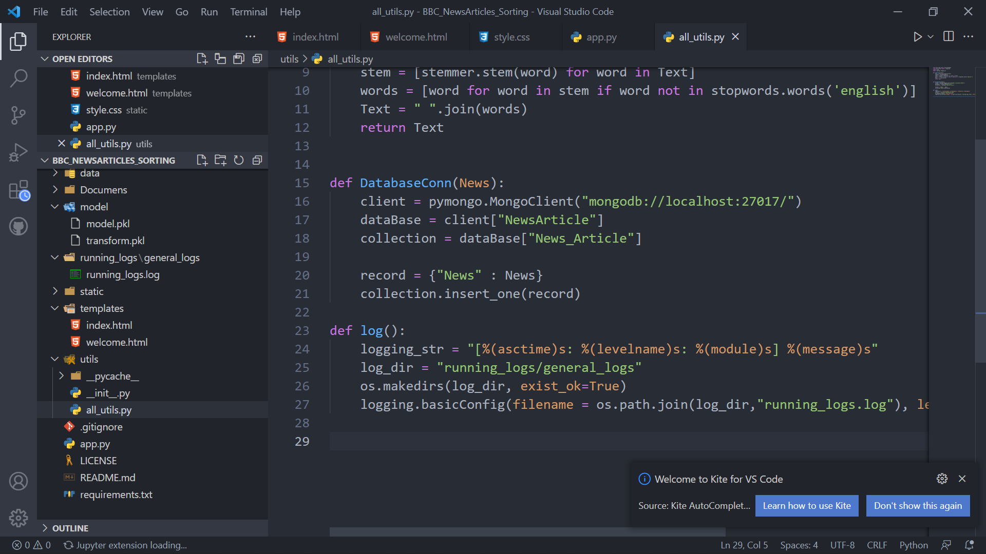

Database
Create Database
Create Collection
Insertion of Data

Slide 14
Model Selection
Evaluate Classification Models using LogisticRegression, Adaboosst Classifier, And multi-nomialNB etc…
Compute metrix and generate graphs for evaluation.
Finally fit multi-nomialNB classifier model with hyperparameter tuning.

Slide 15
Question & Answer
Question 1: Explain about the Project and your day to day task:
This is a NLP based ML web application which is used to classify the News Articles. As a Data Scientist I am involving in each and every phase of the project. My responsibility consisted of gathering the dataset, labelling the data for the model, training the model on the prepared dataset, deploying the training model to the cloud, monitoring the deployed model for any issues.

Slide 16
Question 2: What is a source and size of data?
Kaggle: https://www.kaggle.com/c/learn-ai-bbc/data , Size of the data usually in mb.
Question 3: What was the type of data?
The data was the news paragraph.
Question 4: What is Precision and Recall?
Precision: Out of all the points to be predicted Positive, How many of them are actuall positive.
Recall : Out of all the points that are lebelled positive, how many are predicted positive.

Slide 17
Question 5: What techniques are u using for data preprocessing?
Convert paragraph into tokens.
Stemming each word
Removing stopwords from the data
Using TFIDF vectorizer.
Question 6: Which tool You are used for implementation This model?
IDE : VS Code
Cloud : Azure
Database : mongoDB
Framework : Flask

Slide 18
Question 7: What is Accuracy?
Accuracy is One metrics for evaluating classification Models.
Accuracy = no. of correct Prediction/Total no. of prediction
Question 8: How did you optimize your solution?
Model optimization depends on various factors
Train with better data
Increase the quantity of training data.
Try and use multithreaded approachs.

Slide 19
Question 9: How will you know Which machine learning algorithm to choose for your classification problem?
While there is no fixed rule to choose an algorithm for a classification problem.

Slide 20
OUTPUT

Slide 21
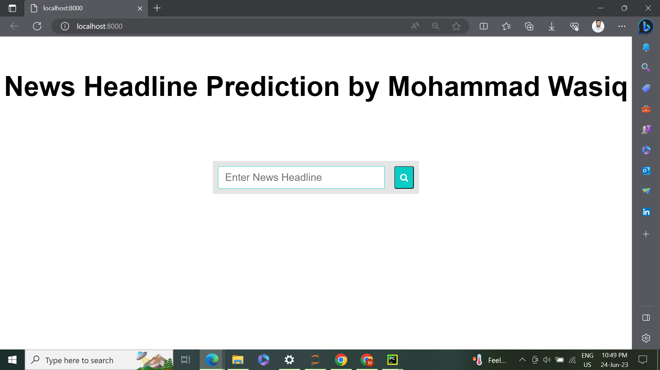

Slide 22
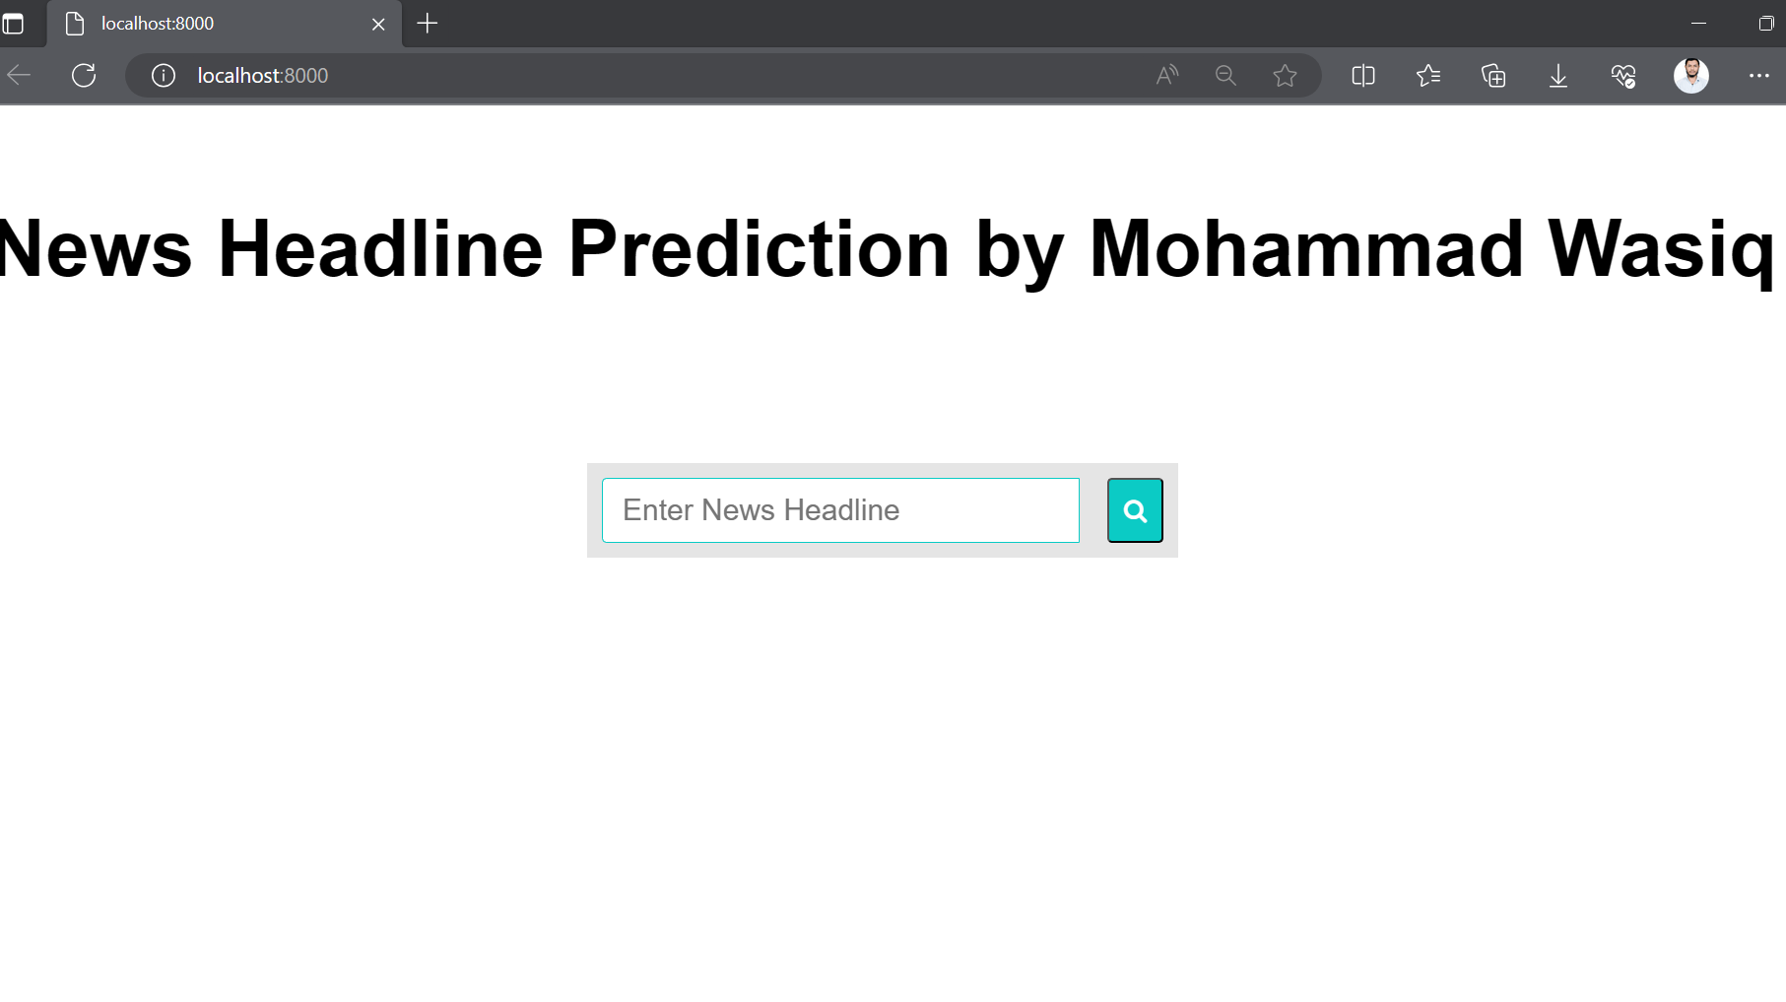

Slide 23
Thank You

